Slide 2
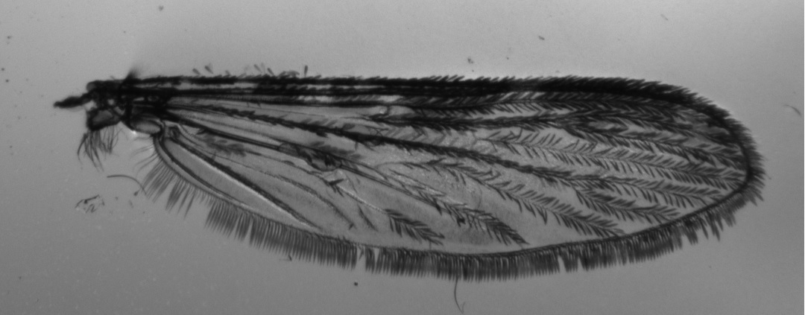
2
1
3
13
16
17
15
4
11
5
14
18
12
6
8
7
9
10

Slide 3
2
4
3
1
11
5
8
6
7
9
13
10
12

Slide 4
13 and 18 landmarks
4
2
1
3
11
8
5
6
7
9
10
13
12

Slide 5
13 and 18 landmarks
2
1
3
13
16
17
15
4
11
5
14
18
12
6
7
8
9
10

